Slide 1
Down syndrome, other full aneuploidies, and polyploidy

Slide 2
Full aneuploidy is presumed in the great majority to be the result of meiotic nondisjunction
Meiotic nondisjunction can happen at any parental age, but it is more frequent in older mothers
Abnormality may arise in premeiotic gametocyte , with the parent having a “wedge” of gonad that carries the abnormality (gonadal mosaicism)
Full aneuploidy may be due to early mitotic nondisjunction in an initially 46,N conception with loss, or restriction to extra-embryonic tissue, of the normal cell line

Slide 3
Down syndrome
The first medical condition shown to result from a chromosome abnormality, in 1959
The most common single known cause of intellectual disability, has the highest incidence at birth of any chromosome abnormality
The phenotype is a “contiguous gene syndrome” caused by an additional dose of a complete set of genes of chromosome 21
Only 225 protein coding genes, a factor in the survivability of the trisomic state

Slide 4
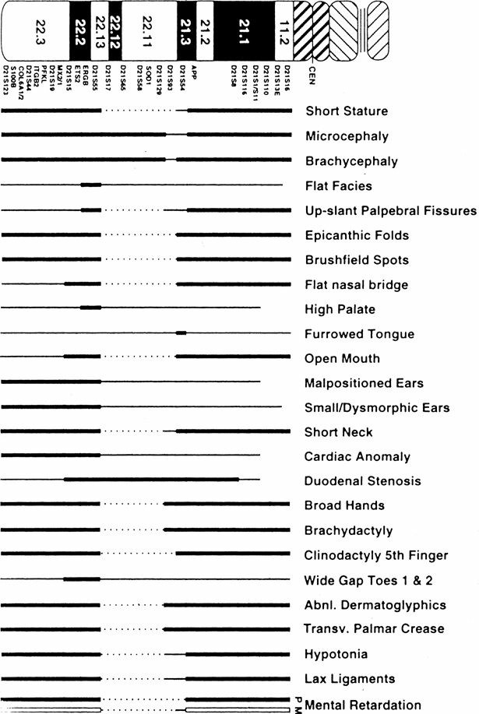
Attempts has been made to define a DS critical region DSCR with some success
On the other hand, an amplified developmental instability hypothesis was suggested in which excess of chromosome 21 encoded gene products perturbs the functioning of the products of many loci, from all chromosomes, in all manner of developmental and physiological pathways
FIGURE 13–1 Phenotypic (trisomic) map of chromosome 21. Thick lines represent regions that must be trisomic to produce the particular trait. Thin-line regions may also contribute to that trait; the contribution of dotted-line regions is less clear. M, mild; P, profound.

Slide 5
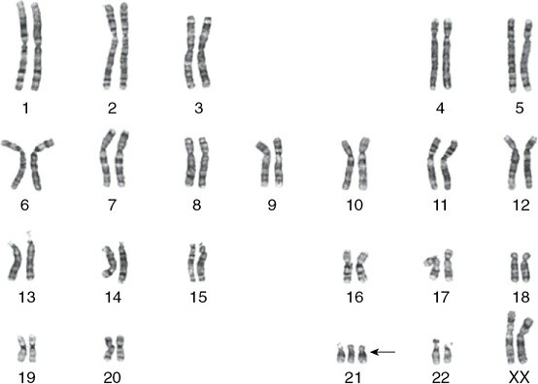
FIGURE 13–2 Karyotype of a child with standard trisomy 21.

Slide 6
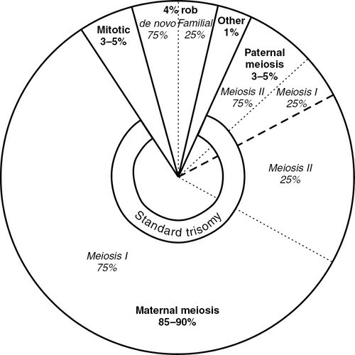
FIGURE 13–3 Origins of trisomy 21 (percentages rounded).

Slide 7
Meiotic I errors are associated with reduced or actual absence of recombination
Standard trisomy DS are typically sporadic with rare recurrence
Exceptions include:
Parental predisposition to nondisjunction
Gonadal mosaicism
Chance
Mosaic Down syndrome accounts for about 2% of individuals with clinically diagnosed DS
Robertsonian translocation, De novo 3%, familial 1%

Slide 8
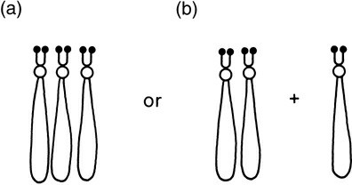
Parent with Down syndrome
Maternal trisomy 21
46,N and 47,+21 conceptions occur with equal frequency, but loss of pregnancy is greater with the trisomic fetuses
Paternal trisomy 21
Spermatogenesis is reduced but not necessarily fail, few examples of fatherhood in DS males have been documented
Parental trisomy 21 mosaicism
FIGURE 13–4 Possible synapsis of three no. 21 chromosomes: (a) as a trivalent and (b) as a bivalent and a univalent.

Slide 9
Trisomy 13, Patau syndrome, 1 in 12,000
Trisomy 18, Edwards syndrome, 1 in 6,000
Both show maternal age effect and in both maternal meiosis is the cause in ~90% of cases
Recurrence is very rare in trisomy 18 and not recorded in trisomy 13

Slide 10
Sex chromosome aneuploidy
XXY, XXX, XYY have similar frequency 1:1000 of the appropriate sex
Majority of XXX is due to maternal meiotic errors
Almost half of XXY is due to maternal meiotic errors
None of XYY is due to maternal errors (paternal MII)
All may have postzygotic mitotic generation, which may present as mosaicism
Turner syndrome
In ~75% of Turner it is the paternal X chromosome that is absent
Recurrence is nearly absent
Could happen postzygotically

Slide 11
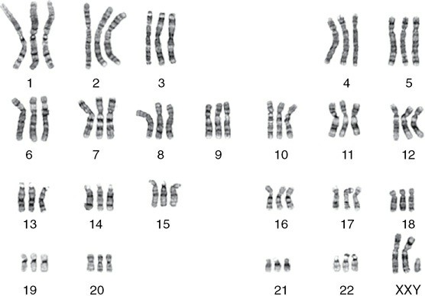
FIGURE 13–5 Karyotype of a 69,XXY triploid fetus
Polyploidy – triploidy

Slide 12
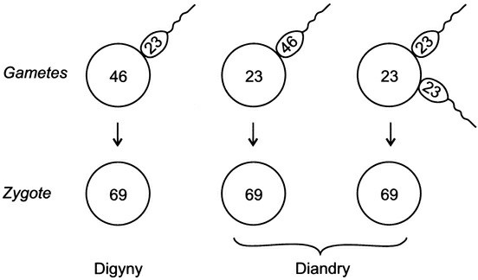
FIGURE 13–6 The three major routes whereby triploidy may arise. A complete failure of a meiotic division produces a diploid egg (left) or sperm (middle). Simultaneous fertilization by two sperm is dispermy (right).
Triploidy occurs in 1% of recognized conceptions, 10% of recognized miscarriages, 99.99% are lost
Tetraploidy, mostly resulting from reduplication of diploid set in zygote

Slide 13
Influence of parental age in predisposing to aneuploidy
Maternal age association of Down syndrome was known long before its chromosomal basis. In 1909 a scientist wrote:
“with regard to parentage… the outstanding point is the advanced age of the mother at the birth of the child… The next point that strikes one is the large proportion of Mongol children that are lastborn, often of a long family”
In a 1996 study, showed oocyte’s meiotic apparatus deterioration with age
However, there is still a lack of understanding of the basic mechanism of the well-established links to maternal age

Slide 14
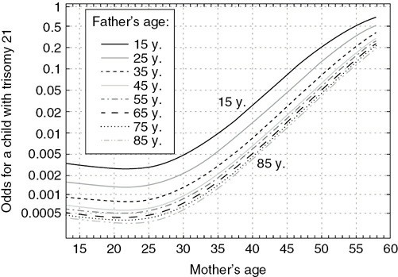
Fathers of DS children are older than average, but simply because couples are usually of similar ages
FIGURE 13–7 Parental ages compared to risk to have a child with Down syndrome. Note that younger paternal age is a slight risk factor, against the well- known and marked older maternal age effect.

Slide 15
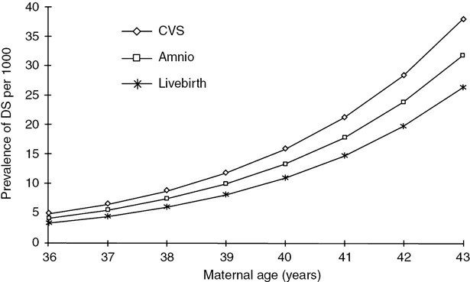
Prevalence of chromosome abnormality is greater at the time of prenatal diagnosis than at term
For trisomy 21, it is estimated that about one-third of all pregnancies existing at the time of CVS spontaneously abort between then and term, and one-quarter abort during the period from amniocentesis to term
FIGURE 13–8 Prevalence of Down syndrome for maternal ages 36–43 years, at three “windows of observation”: the time at which CVS is done (~10 weeks), amniocentesis (15–17 weeks), and at live birth.

